Slide 1
openDRIVE Map Generation
Share: Lingtong Zhang

Slide 2
First of all, thanks to all your guys “BrainStorm”

Slide 3
Outline
openstreet map(OSM) VS openDRIVE map(ODM)
Introduction of ODM
openDRIVE 1.0 VS openDRIVE 1.5
Automatic Generation of ODM
Demo of Generation

Slide 4

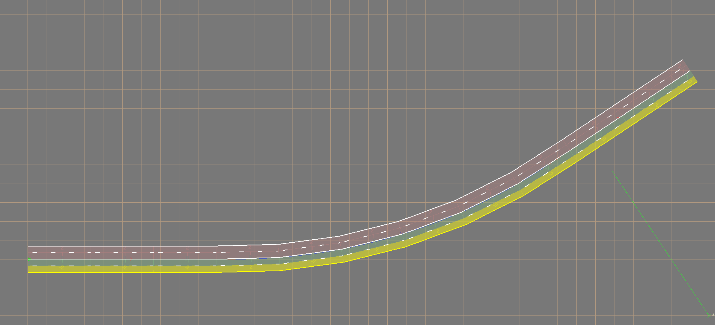
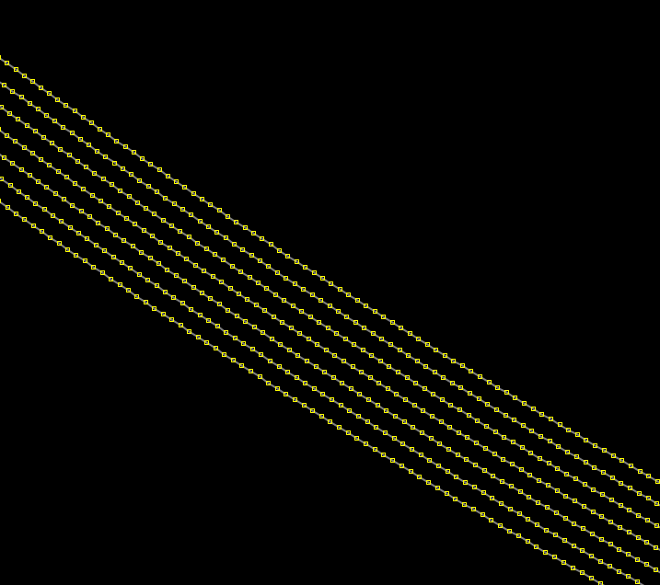
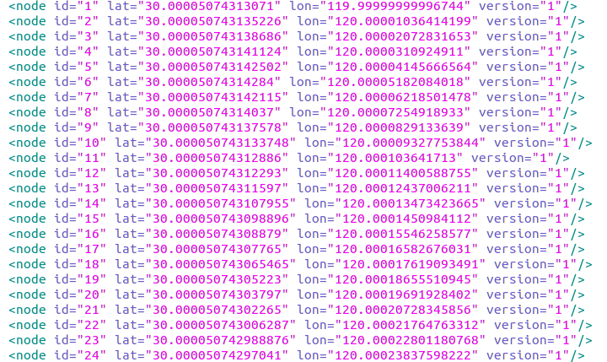
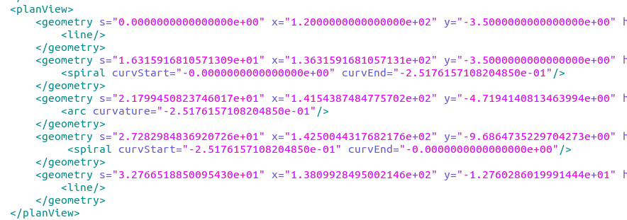
OSM VS. ODM
Road Geometry
Items | Comparisons
Location | OSM: Lat, Lon ODM: X, Y(at inertial coordinate)
Components | OSM: Nodes ODM: Geometry line
Type | OSM: Line shaped by discritized nodes ODM: Baseline(arc, line, spiral)
line
spiral
arc
Description

Slide 5
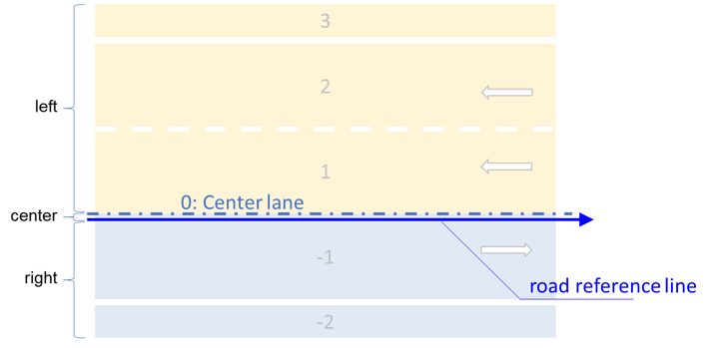
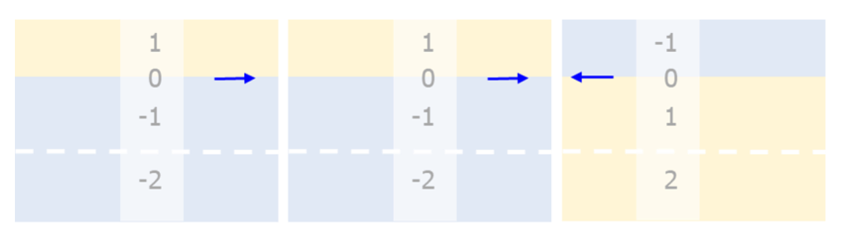
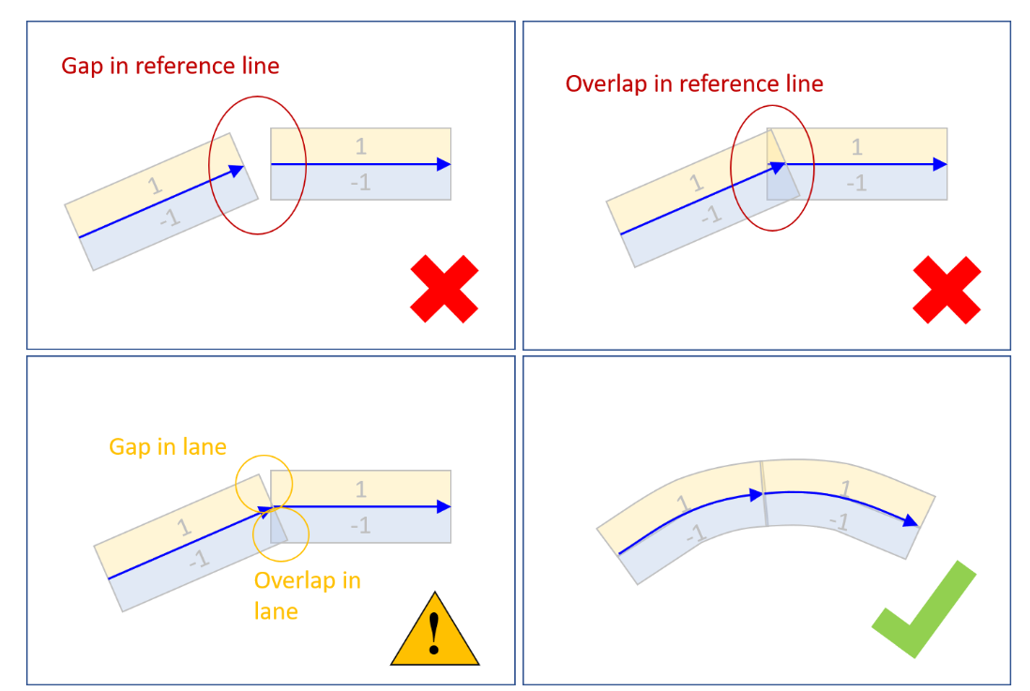
OSM VS. ODM
Roads & Lanes
Items | Comparisons
Lanes | OSM: Edges(shaped by nodes) ODM: Generated based on road reference line
Lane linkage | OSM: Ambigious lane linkage ODM: Specific linkage for each road lane
Roads | OSM: - ODM: Defined by road geometry
Road linkage | OSM: - ODM: Strict connection of road geometry

Slide 6
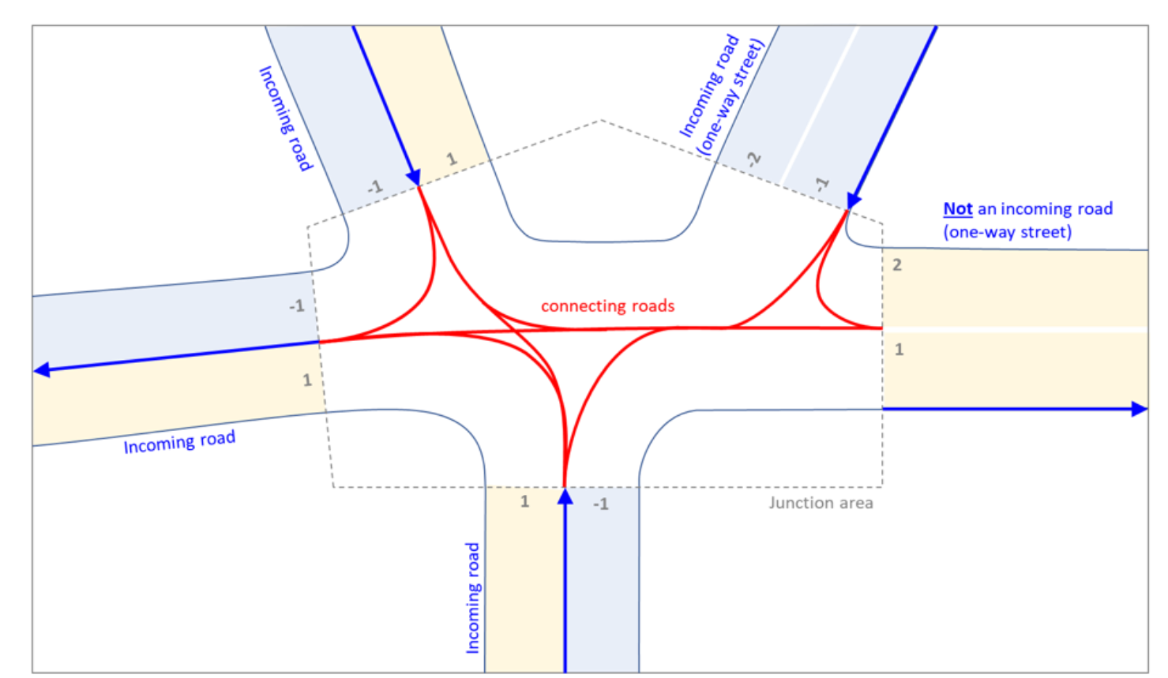
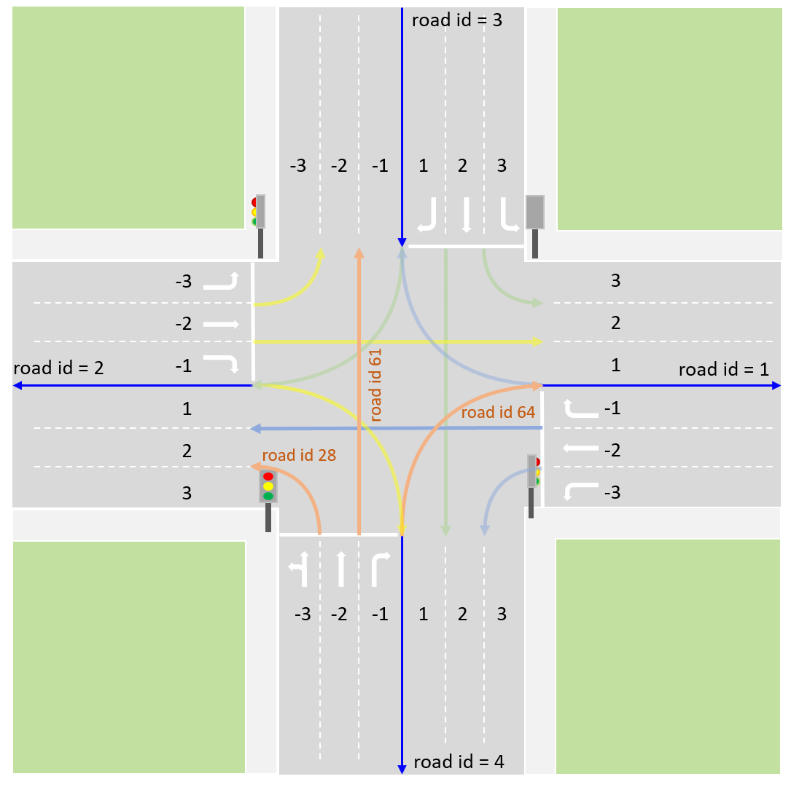
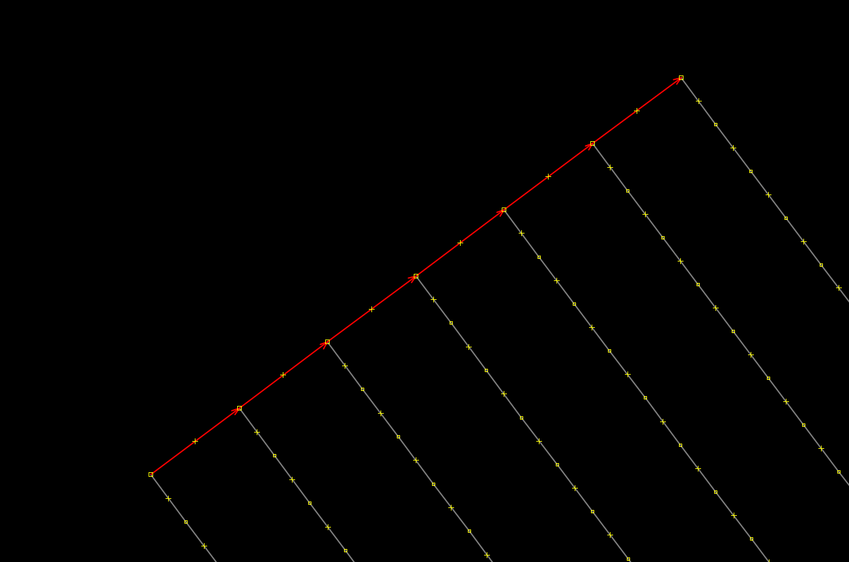
OSM VS. ODM
Road Connection
Items | Comparisons
Connector | OSM: Edges(shaped by nodes) ODM: Connecting Roads(road segments)
Connection Discription | OSM: No discription ODM: 1. Connection direction 2. Lane connection details
Junctions | OSM: - ODM: Composed of connecting roads

Slide 7
Why ODM
Easy Definition of road segments based on road geometry instead of numerous nodes
Easy Definition of road lanes ( lanes with constant lanewidth are generated parallelly to road reference lines )
Detailed linkage between roads/lanes for sophisticated road net by using junction element
Simplify description of testing map
Simplified connection desciption between different road geometries without the concerns of curve continuity.

Slide 8
Outline
openstreet map(OSM) VS openDRIVE map(ODM)
Introduction of ODM
openDRIVE 1.0 VS openDRIVE 1.5
Automatic Generation of ODM
Demo of Generation

Slide 9
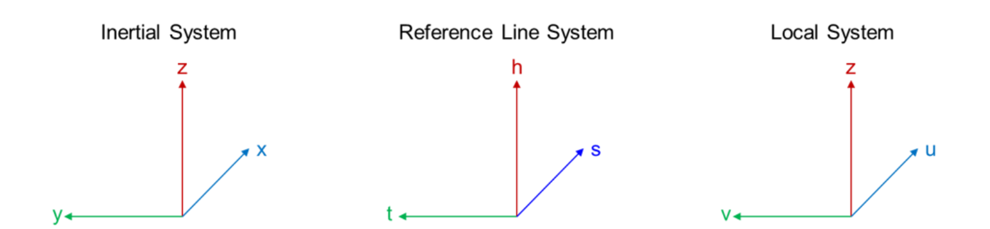
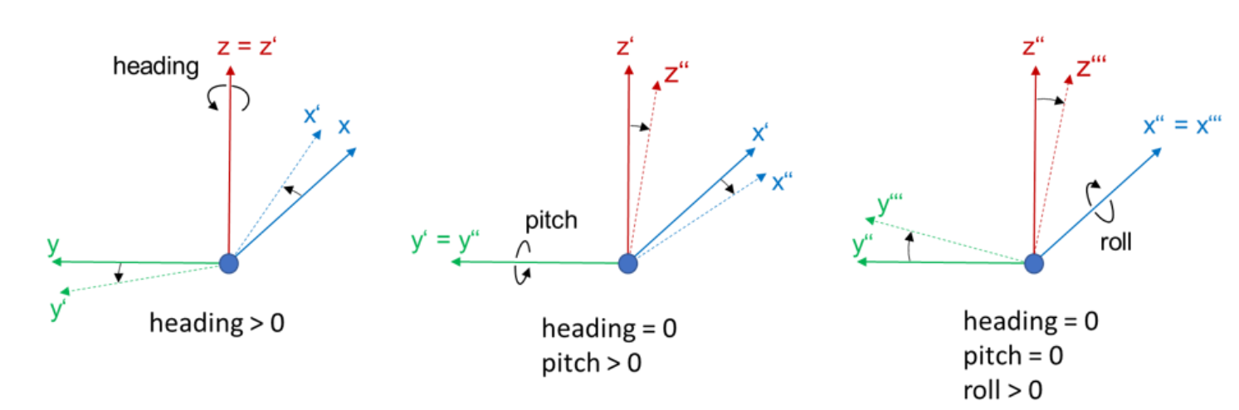
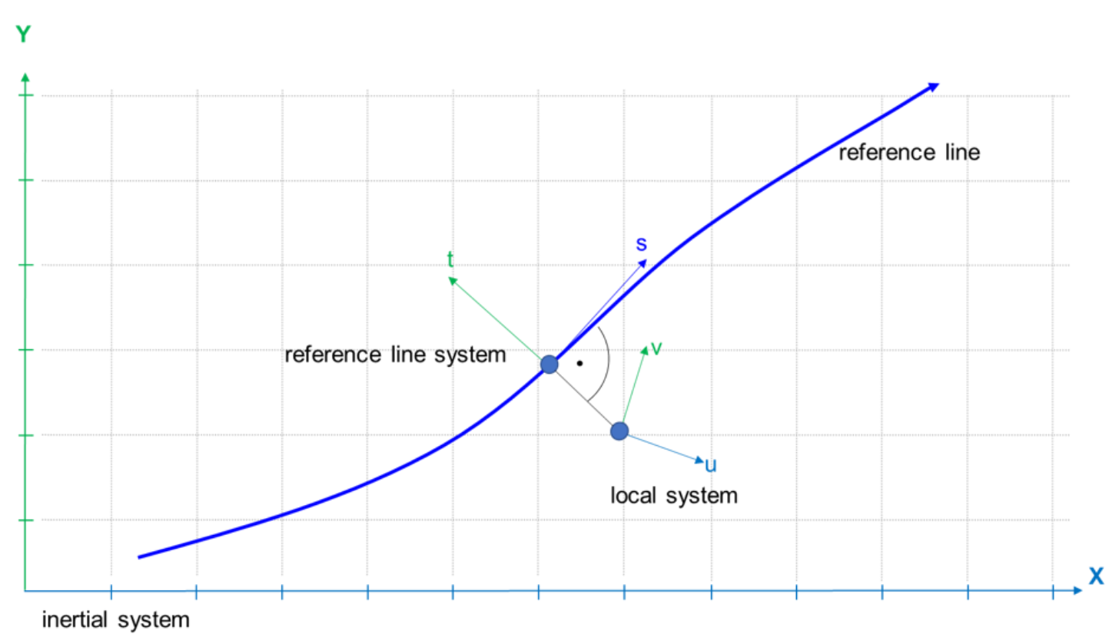
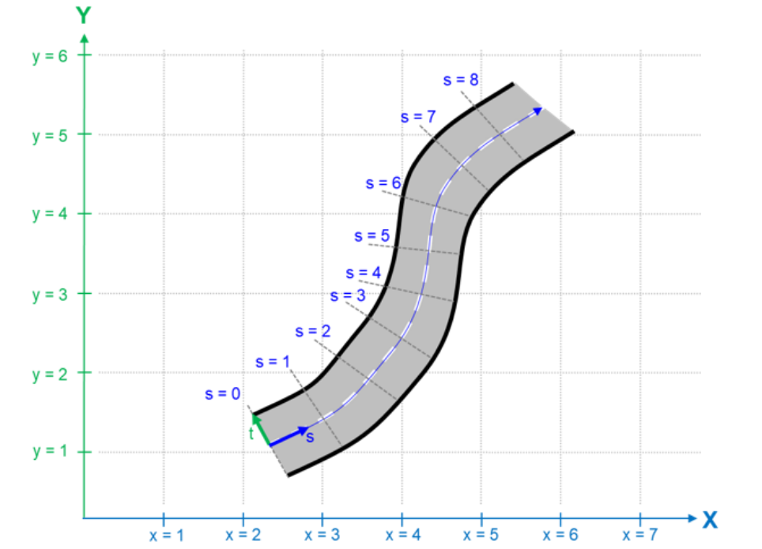
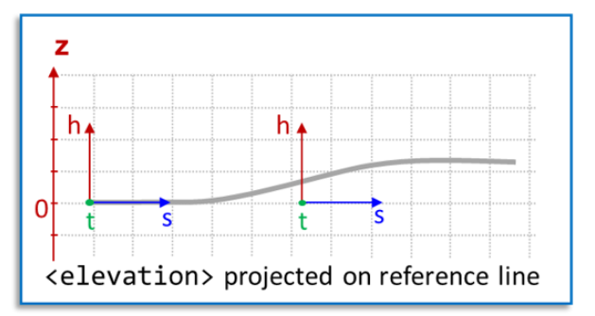
Coordinate System
Inertial system:
Right-handed (X-right, Y-up, Z- coming out of drawing plane)
Geometry reference(X-east, Y-north, Z-up)
Reference line system:
Right-handed (s-along the reference line, t-vertical to the reference line, h-relavant to
elevations)
With respect to inertial coordinate system
local system:
Right-handed (U-forward, V-left, Z-up)
With respect to reference coordinate system

Slide 10
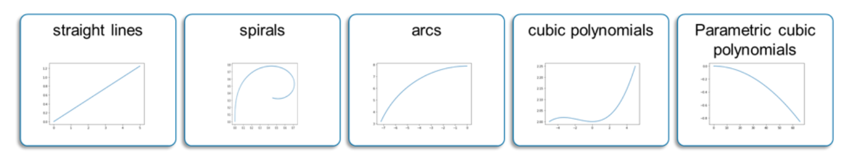
Geometry
ODM has provided several geometry elements for customized road design.
Notice that current mainly used elements are straight lines, spirals and arcs, the remainings are dumped gradually.
Attributes
S- used for the determination of current start s position of a specific road geometry in road reference line system.
X- start x position in inertial system
Y- start y position in inertial system
hdg- heading of start point relevant to inertial system
length- length of current road geometry along the reference line (travelled distance along s-direction)

Slide 11
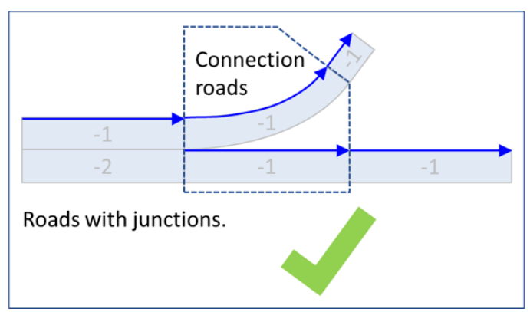
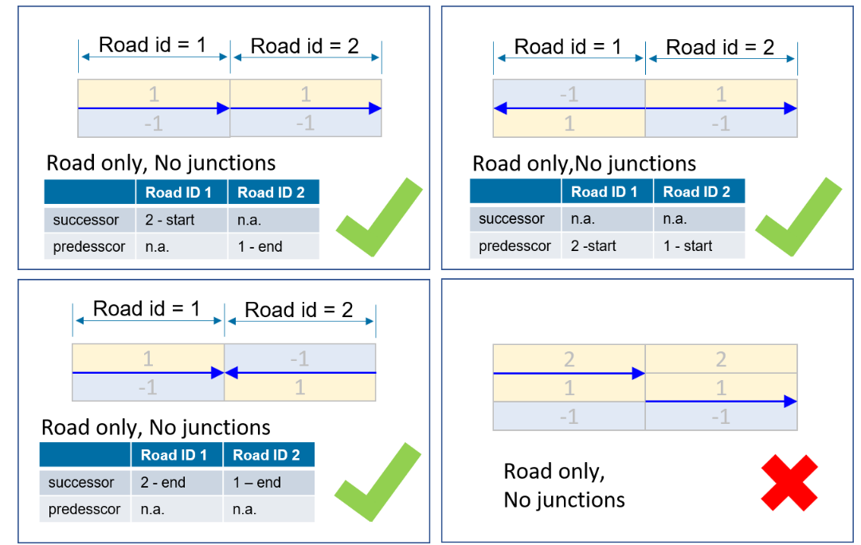
Roads
Attributes
junction: which junction current road segment belongs to ( default value is “-1”)
length: the total length of all road geometries.
id: current road id
rule: basic rule for using the road(right-hand traffic or left hand traffic
A road contains informations of subelements like planview(an overview of road geometries), lanes (speficication of lane components)
Relations- predecessor, successor, junction

Slide 12
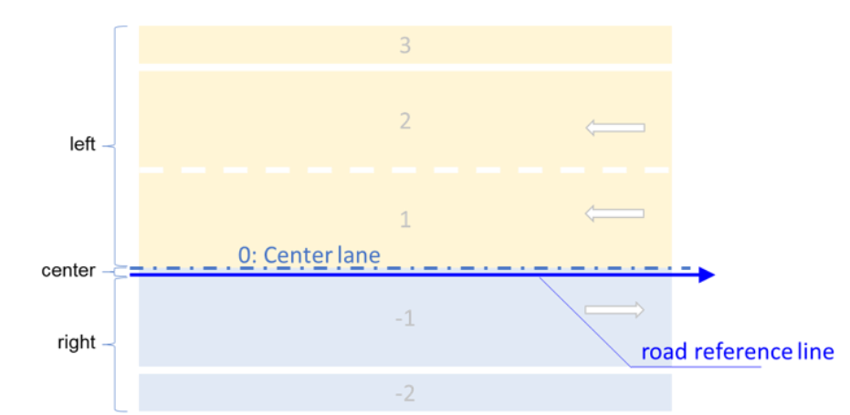
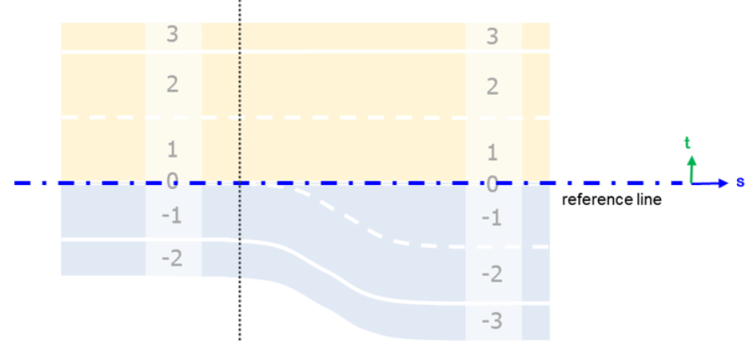
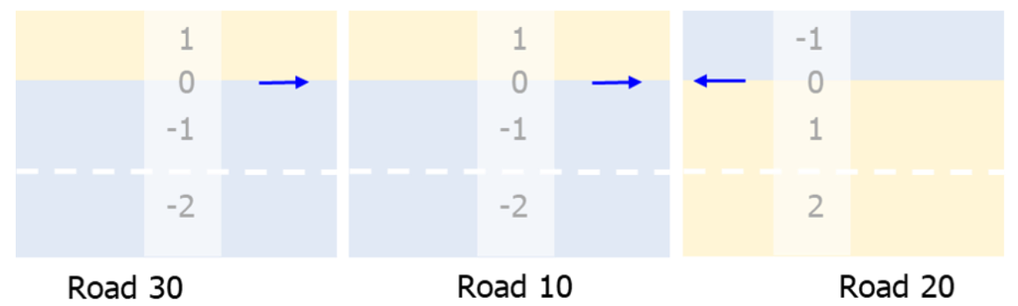
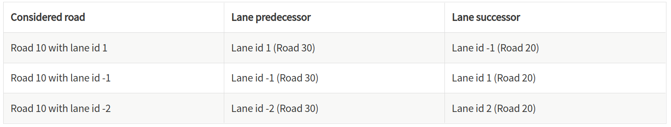
Lanes
center line is coinside with road reference line
different driving directions for left and right lanes
Lane Sections
lane sections are settled, where the number of lanes changes
Lane Linkage
lane linkage is described by means of predecessor and successor information for each lane.

Slide 13
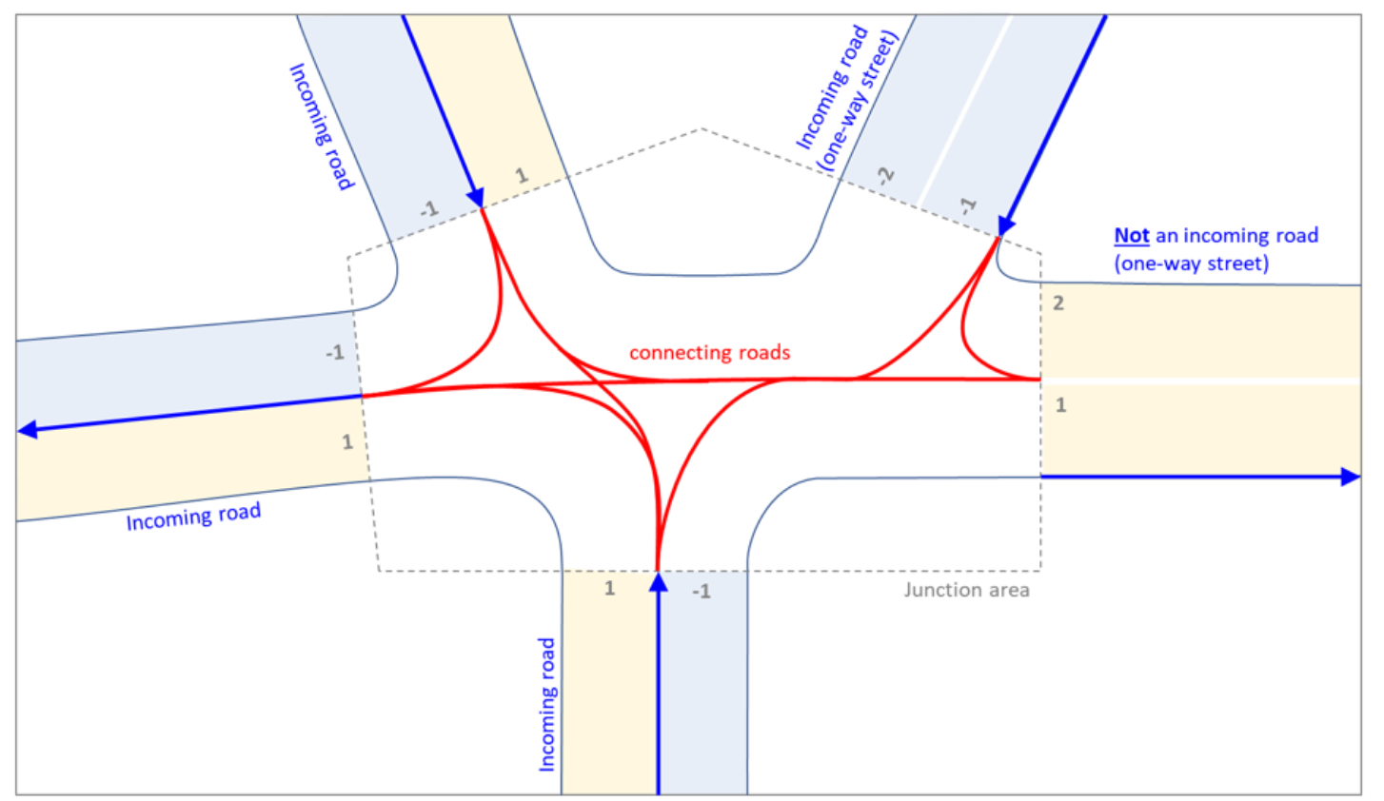
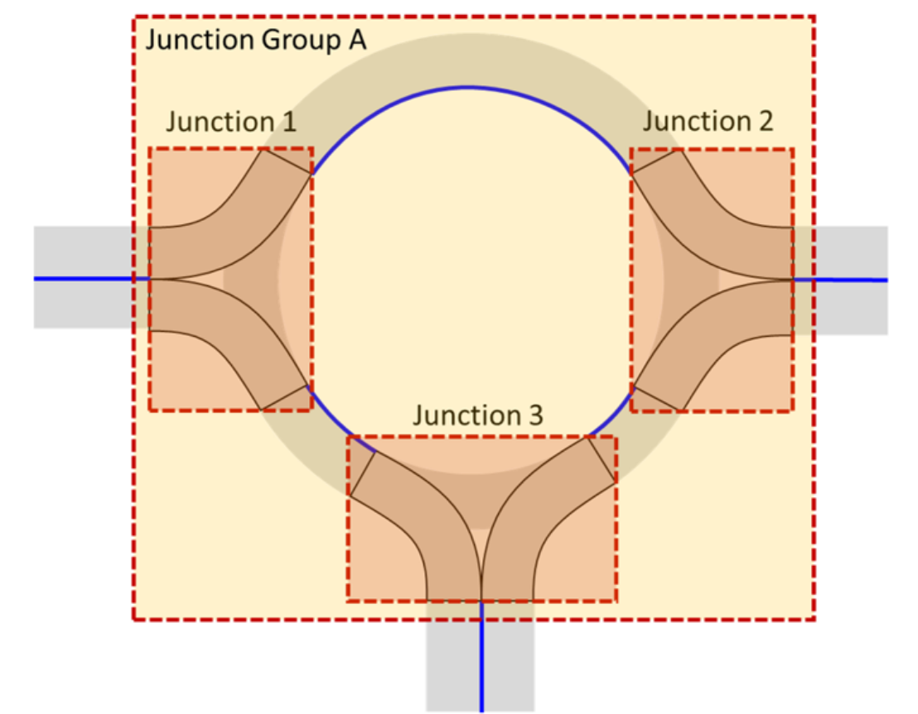
Junctions
Junction is used to describe road relations when one road has simutaneously more than one successor road or predecessor road.
In junction, roads connections are described by connecting roads. A connecting road may only have one predecessor road and sucessor road.
Two or more junctions may be grouped in junction groups to indicate that these junctions belong to the same roundabout.

Slide 14
Overview of ODM static map
<Opendrive>
<header>
<road>
<planview> -- geometries description
<elevationProfile> -- elevation description
<lateralProfile> -- roll description
<lanes> -- lanes definition
<left>
<link>
<roadmark>
<width>
<center>
<right>
</lanes>
</road>
<junction> -- junctions description
<connection>
</junction>
<objects> -- static environmental objects

Slide 15
Outline
openstreet map(OSM) VS openDRIVE map(ODM)
Introduction of ODM
openDRIVE 1.0 VS openDRIVE 1.5
Automatic Generation of ODM
Demo of Generation

Slide 16
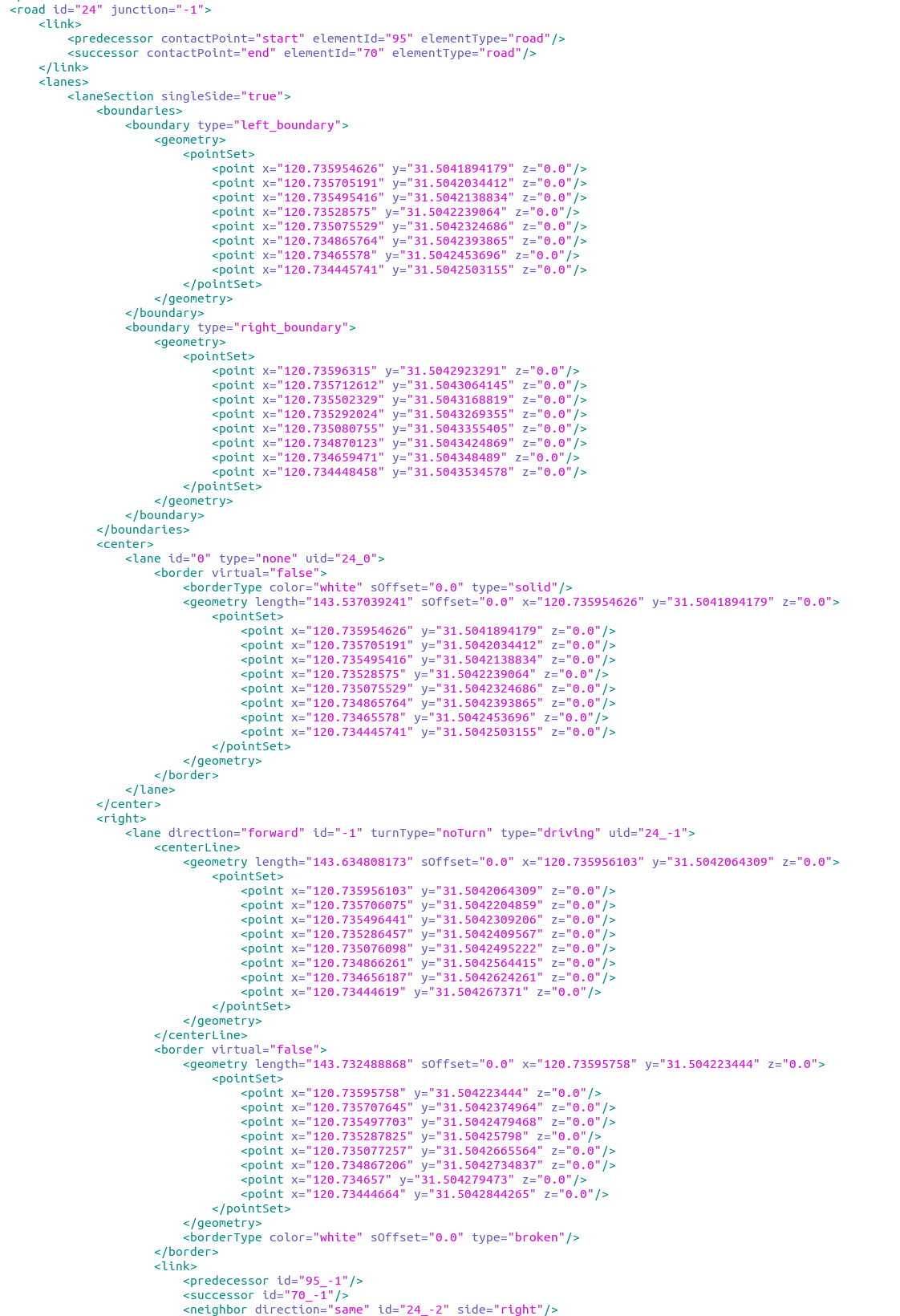
ODM 1.0 VS. ODM 1.5
No planview
Discritized road geometry points
Boundary based lane definition
Inertial coordinate system based roadway points

Slide 17
Outline
openstreet map(OSM) VS openDRIVE map(ODM)
Introduction of ODM
Automatic Generation of ODM
Demo of Generation

Slide 18
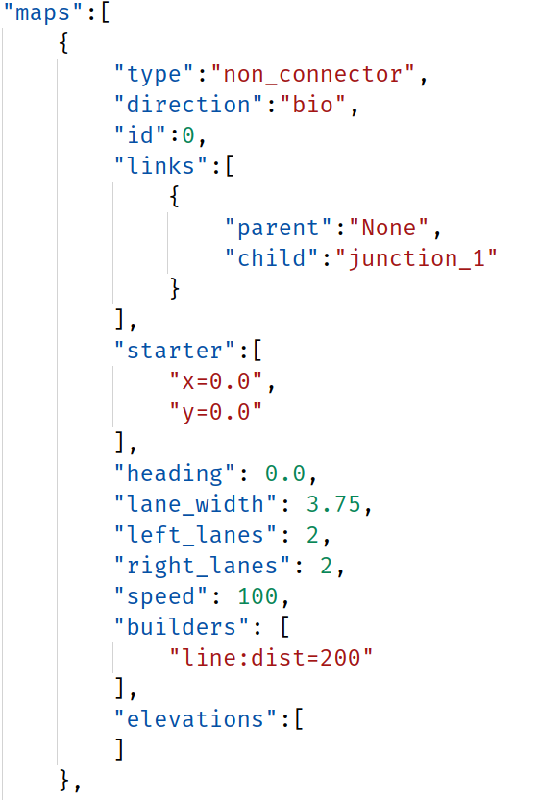
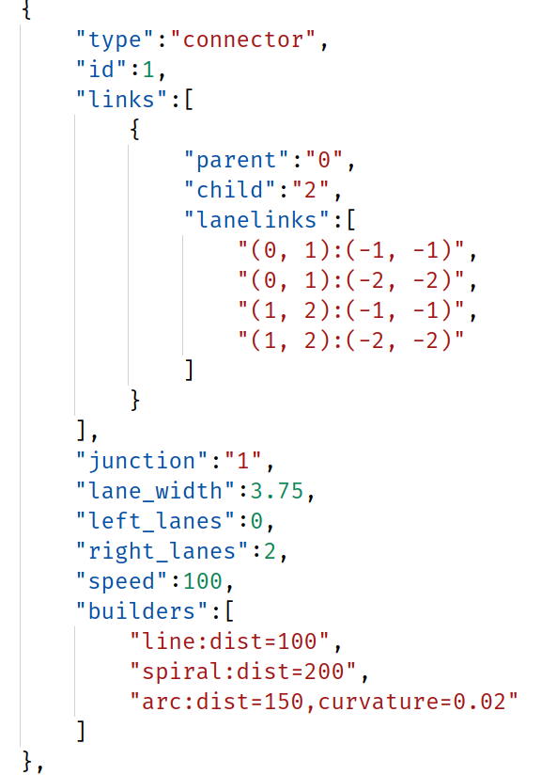
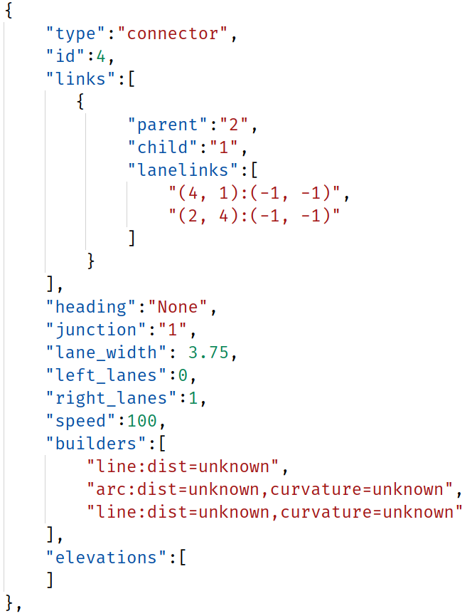
Json map definition

Slide 19
Outline
openstreet map(OSM) VS openDRIVE map(ODM)
Introduction of ODM
Automatic Generation of ODM
Demo of Generation

Slide 20
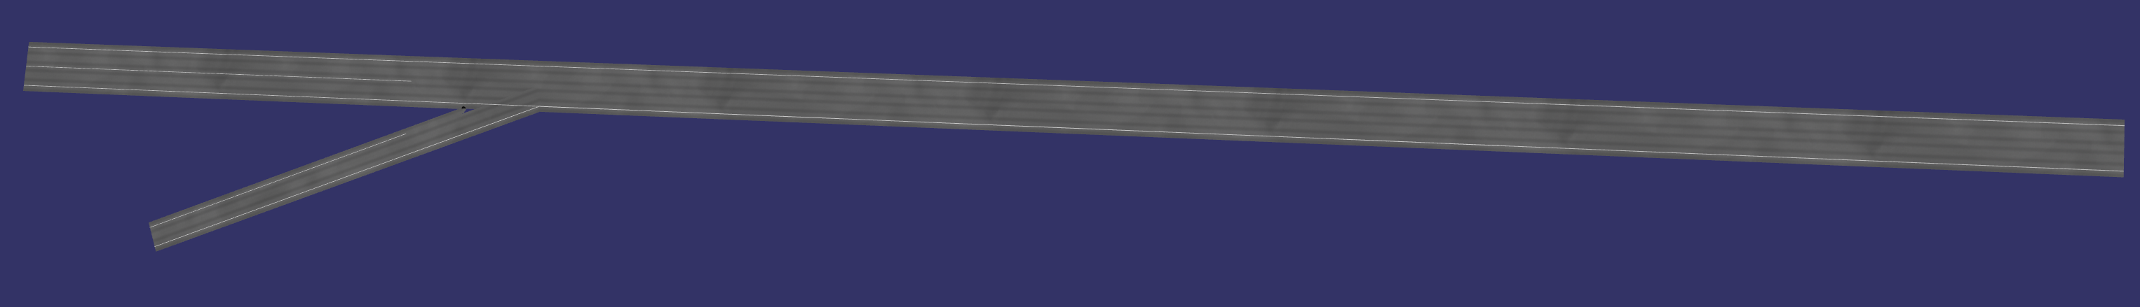
Demo in VTD

